Slide 1

Inferential Statistics with Python
Rounak Banik

Slide 2


Acknowledgements

Slide 3
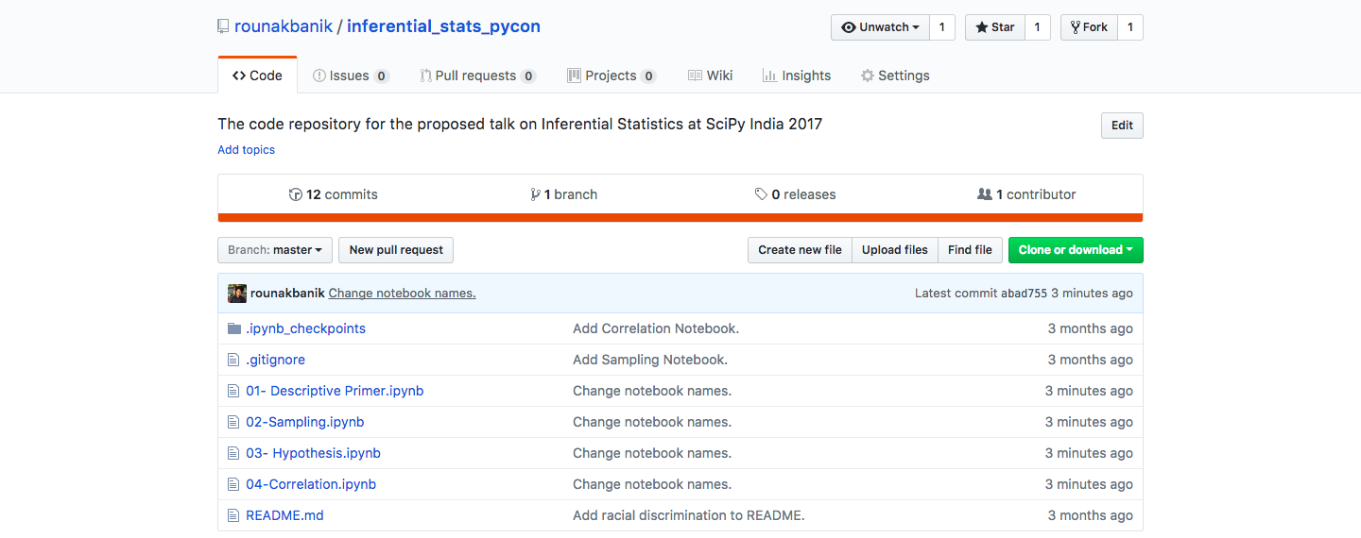
github.com/rounakbanik/inferential_stats_pycon

Slide 4
Contents
Descriptive Statistics Primer Central Tendencies, Measures of Spread, Binomial and Normal Distributions, Normalcy Test, Z-Scores and p-values.
Sampling Estimation of Population Proportion and Mean, The Central Limit Theorem
Hypothesis Testing and Statistical Tests Null and Alternate Hypotheses, One and Two Sample Significance Tests, Chi-Squared Significance Tests
Ethics and Standards in Inferential Statistics Sampling Bias, Statistical v/s Practical Significance, Misusing p-values

Slide 5
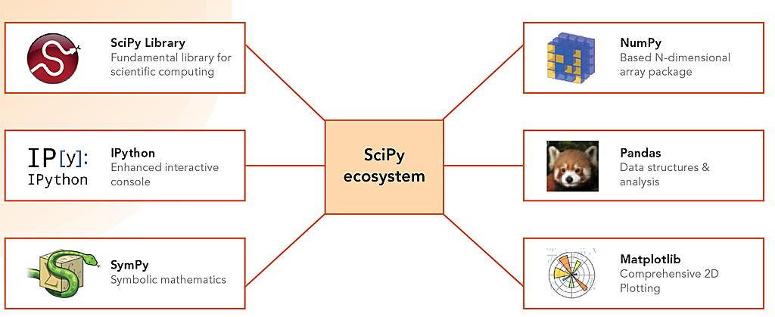
Tools

Slide 6
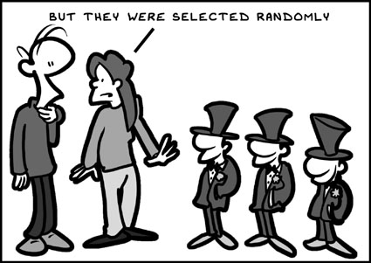
Sampling

Slide 7

Credit Card Frauds
What fraction of credit card transactions are fraudulent?

Slide 8

Olympian Weights
What is the average weight of an Olympian athlete?

Slide 9
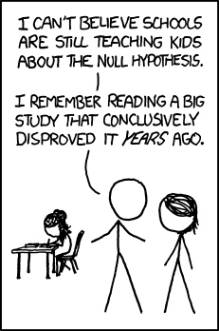
Hypothesis Testing

Slide 10
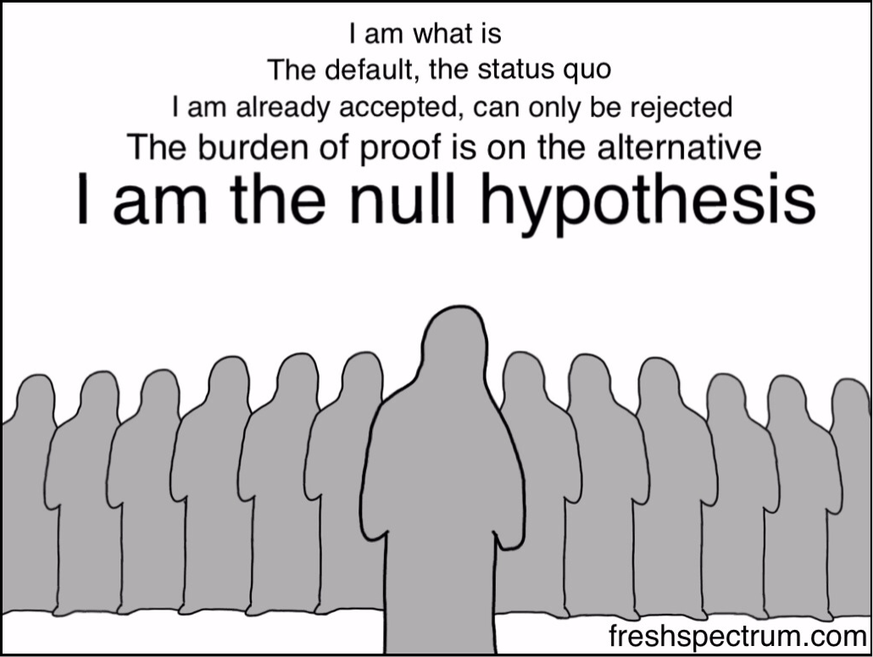
Terminology
Null and Alternate Hypotheses
Significance Level
Statistical Test
P-Values

Slide 11
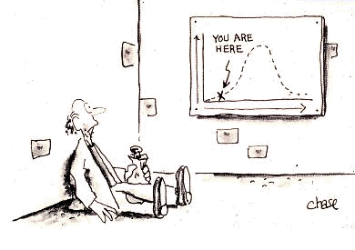
Steps
Formulate the Null and the Alternate Hypothesis.​
Decide on the Statistical Test to use.​
Calculate the p-value​
Compare p-value to the significance level, alpha. Reject/Accept Null Hypothesis based on the comparison.
Summarize the result

Slide 12

Suicide by Gender
In India, are men as likely as women to commit suicide?

Slide 13

NBA Player Heights
What is the average height of NBA players?

Slide 14

Literacy Rates
How do the literacy rates in Delhi and Punjab compare?

Slide 15

Airbnb Destinations
Do men and women prefer certain countries for Airbnb bookings?

Slide 16

Racial Discrimination
Are blacks as likely to get an interview call as whites?

Slide 17
Ethics and Standards

Slide 18

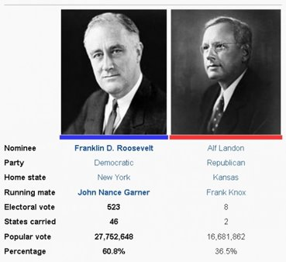
Quality and Quantity

Slide 19
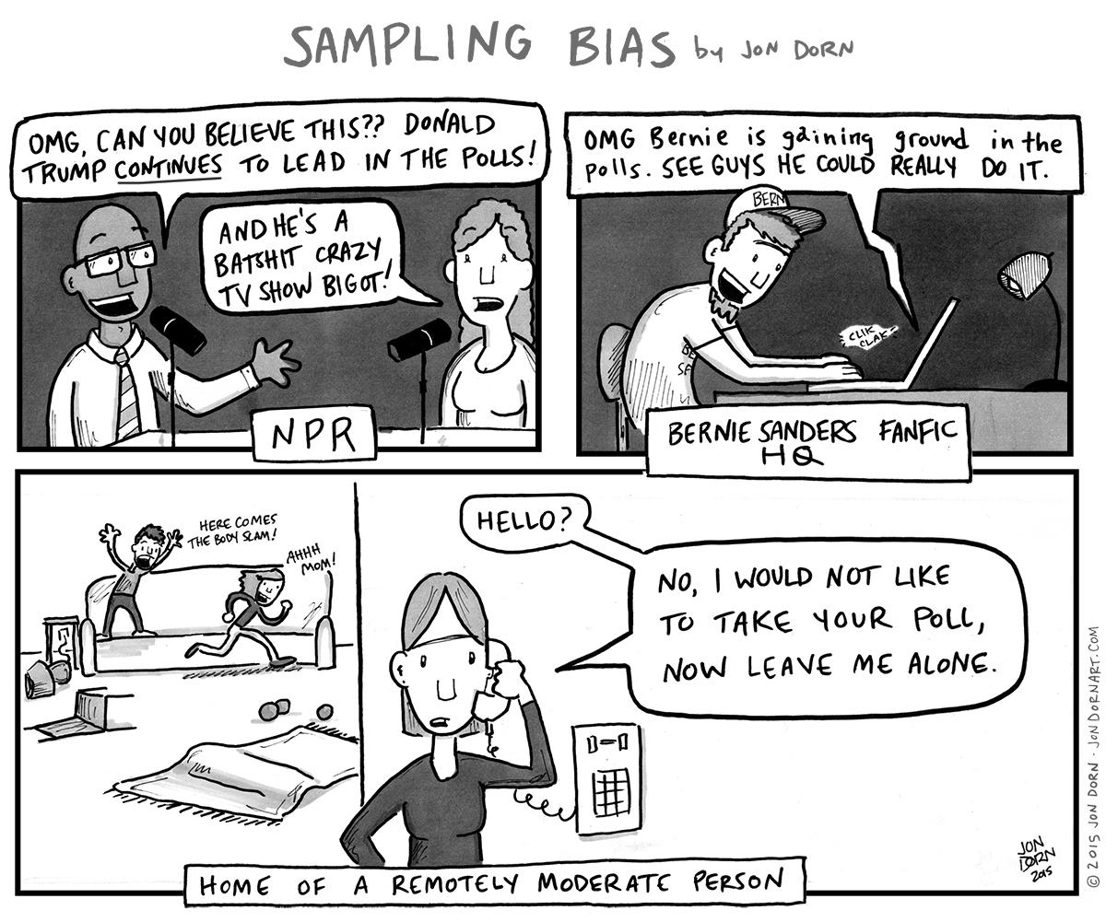
Sampling Bias
Deterministic bias​
Small number of observations​
Selection bias​
Confirmation bias​
Inaccuracy

Slide 20

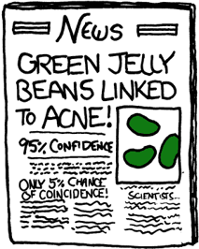
Statistical and Practical Significance

Slide 21
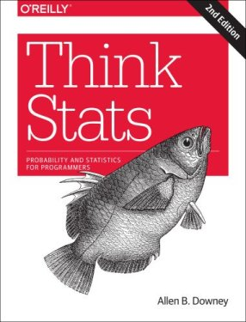
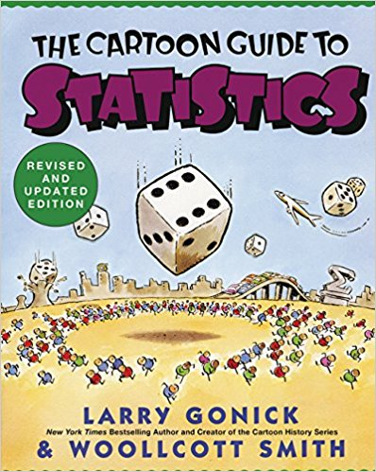

Further Reading

Slide 22
The End
Rounak Banik
E-Mail: rounakbanik@gmail.com

